Slide 1
Business Process Engineering
Sobia Iftikhar

Slide 2
Content
Properties of Business Processes & Business Process Management Architectures

Slide 3
Central Idea
The investigation of properties of business process models is an important aspect of business process management.
If a certain property at the business process model level can be shown, then all process instances based on that business process model expose this property.

Slide 4
Properties of Business Processes
Data Dependencies
Structural Soundness
Relaxed Soundness
Weak Soundness
Lazy Soundness
Soundness
Motivation of Soundness
Definition
Soundness Theorem

Slide 5
Data Dependencies
Application data are an integral part of business processes.
Data can be created, modified, and deleted during the execution of business processes.
Since business processes consist of a set of activities that are related, these activities operate on an integrated set of application data.
Data in business process models has two aspects, both of which need to be covered:
• Data that activity instances manipulate by invoking applications or services.
• Data dependencies between process activities.

Slide 6
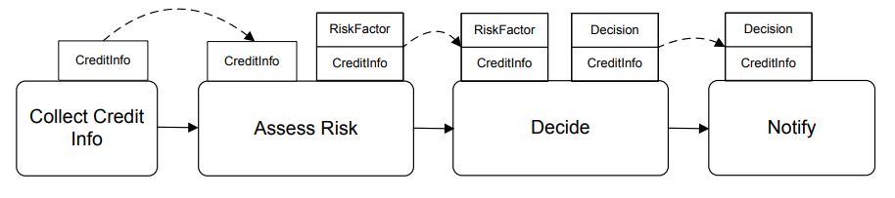
Data Dependencies
There are data dependencies between the activities mentioned
. Only when this data is available
There are data dependencies between the activities mentioned. The Collect Credit Info activity is the first activity performed. Only when this data is available, can the risk be assessed in the Assess Risk activity, the final decision be made(Decide), and the requestor be notified (Notify). Therefore, the ordering of the activities in the business process is strongly related to the data dependencies of the activities.
An example of data flow in a business process in the financial sector is given. A credit approval business process contains activities to enter a credit request, to assess the risks of granting the credit, and to inform the customer about the decision made by the financial institution.

Slide 7
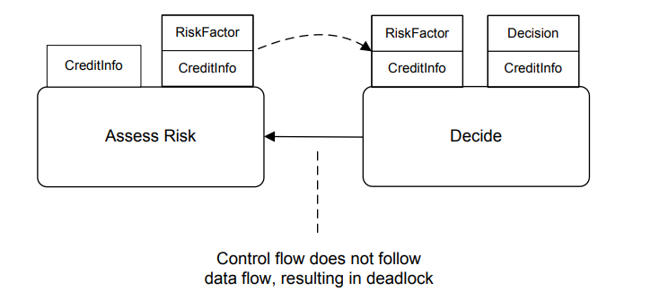
Data Dependencies
This property is known as control flow follows data flow.
Control flow needs to follow data flow, since otherwise the process instance would come to halt.
neither of these activities can be started, because control flow defines that Assess Risk can only start after Decide has completed, and Decide can only start after Assess Risk has generated the risk factor data value.

Slide 8
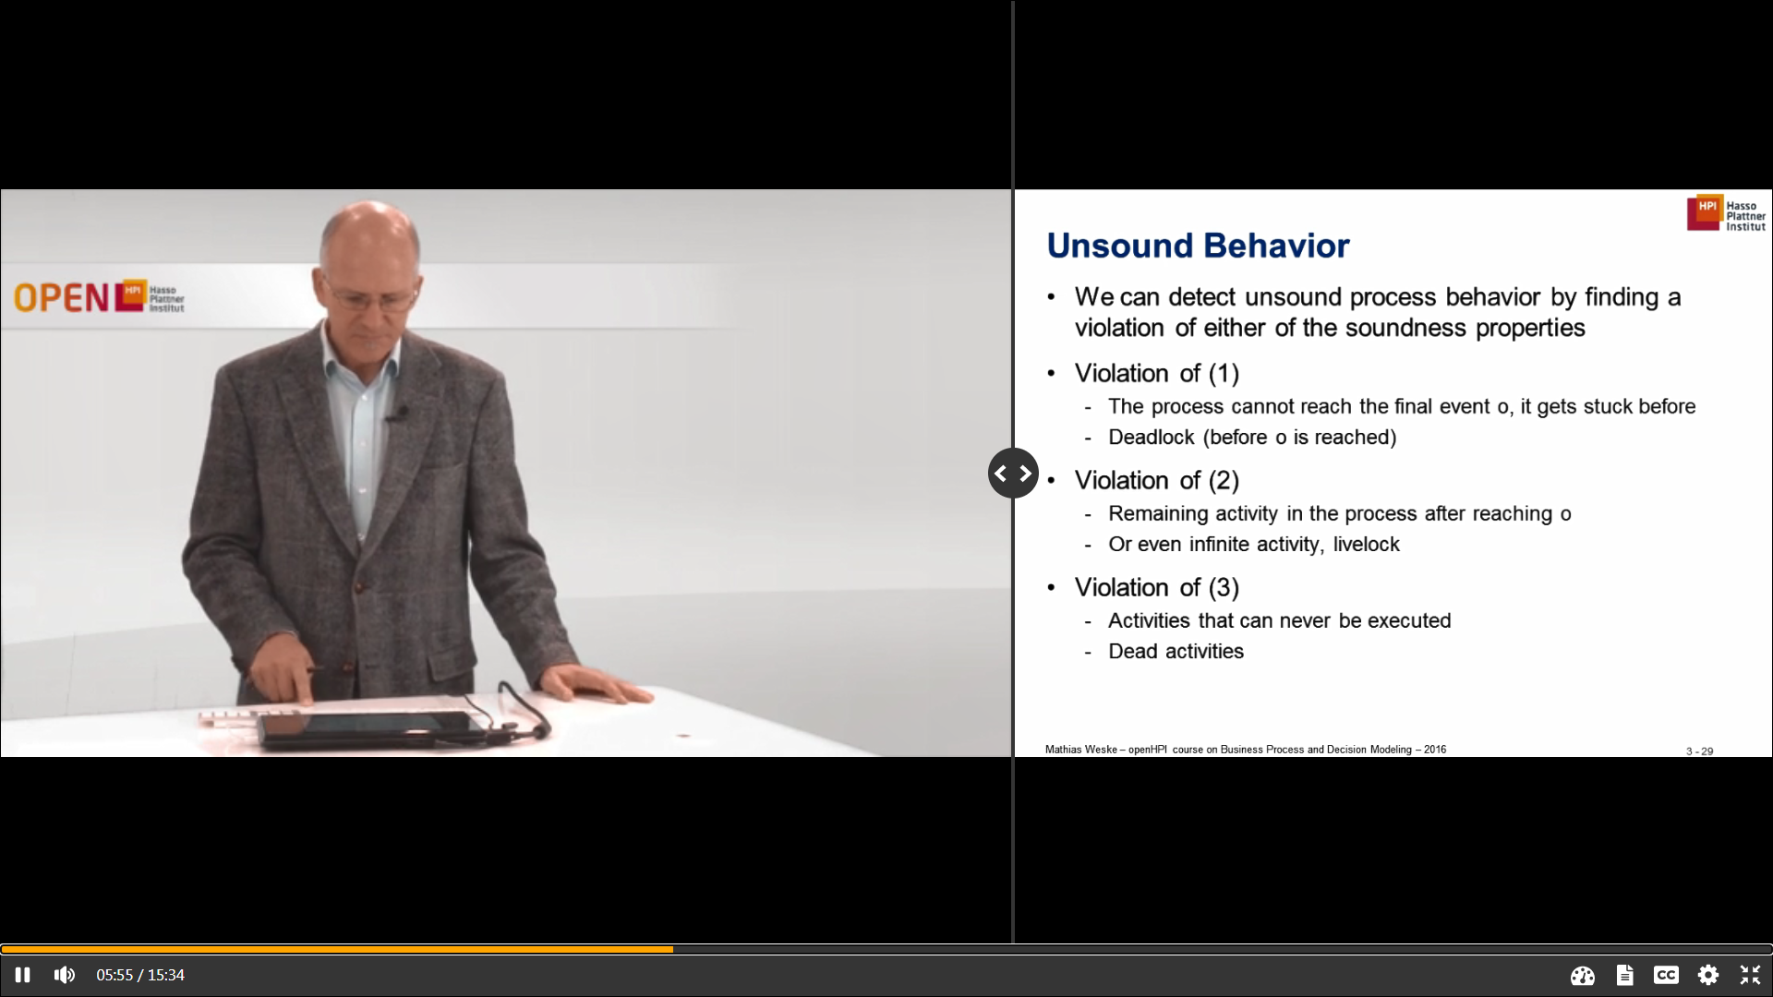
Unsound Behaviour

Slide 9
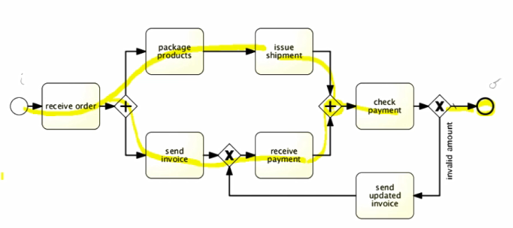
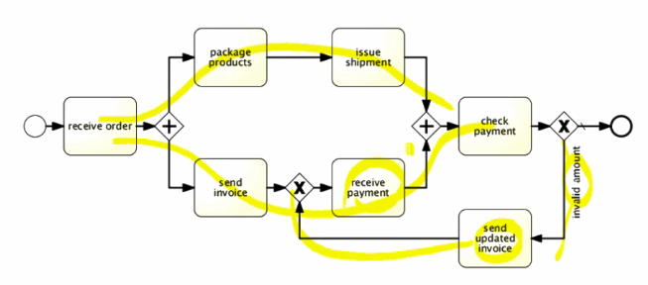
Violation 01-deadlock

Slide 10
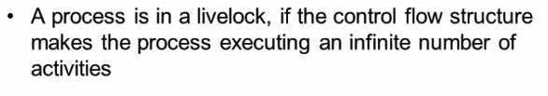
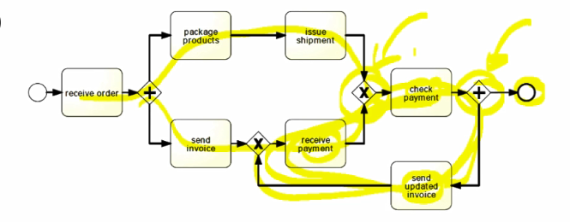
Violation 02

Slide 11
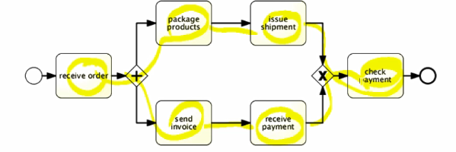
Violation 03-dead activities

Slide 12
Structural Soundness
Soundness assume that a process is structurally sound.
A process model is structurally sound if the criterion that a process model should fulfill. following conditions hold:
There is exactly one initial node, which is only node without any incoming edges. (i)
There is exactly one final node, which is only node without any outgoing edges. (o)
Each node in the process model is on a path from the initial node to the final node. (i) to (o)

Slide 13
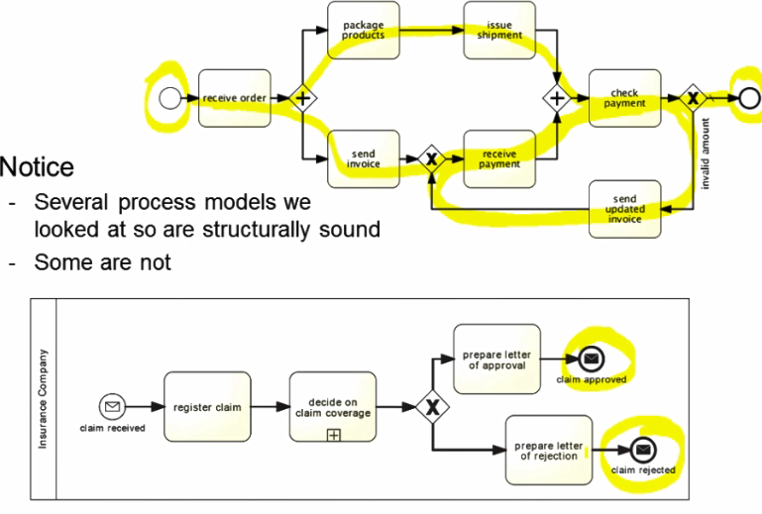
Example

Slide 14
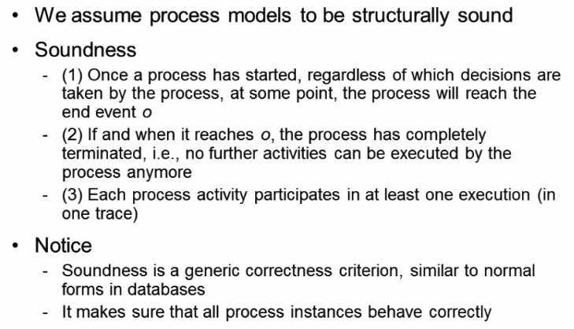
Soundness criterion

Slide 15
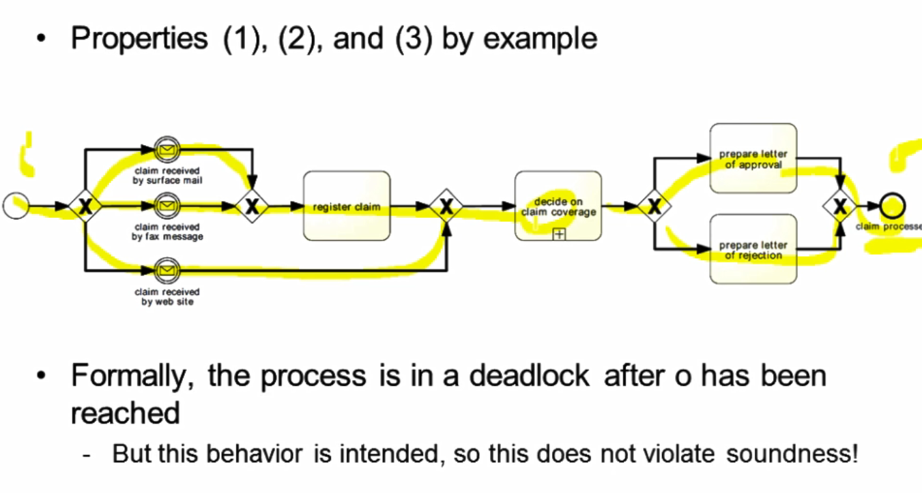
Soundness criterion-Properties

Slide 16
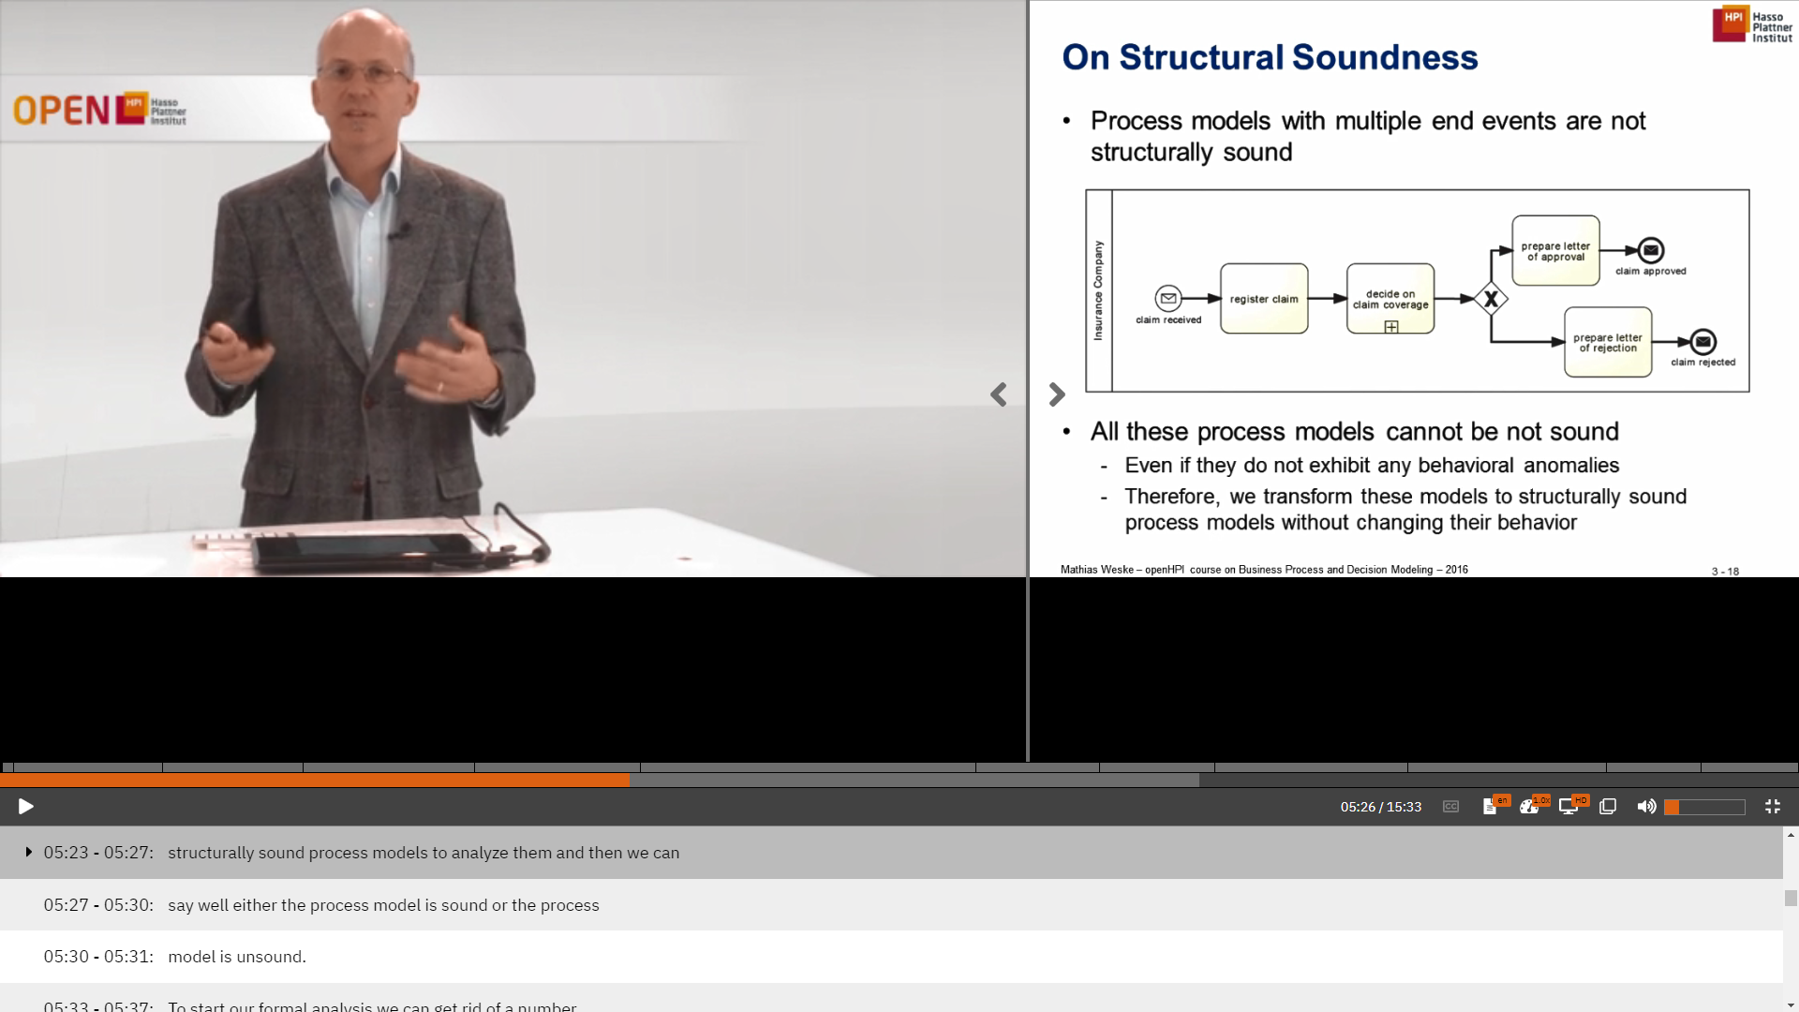
Structural Soundness

Slide 17
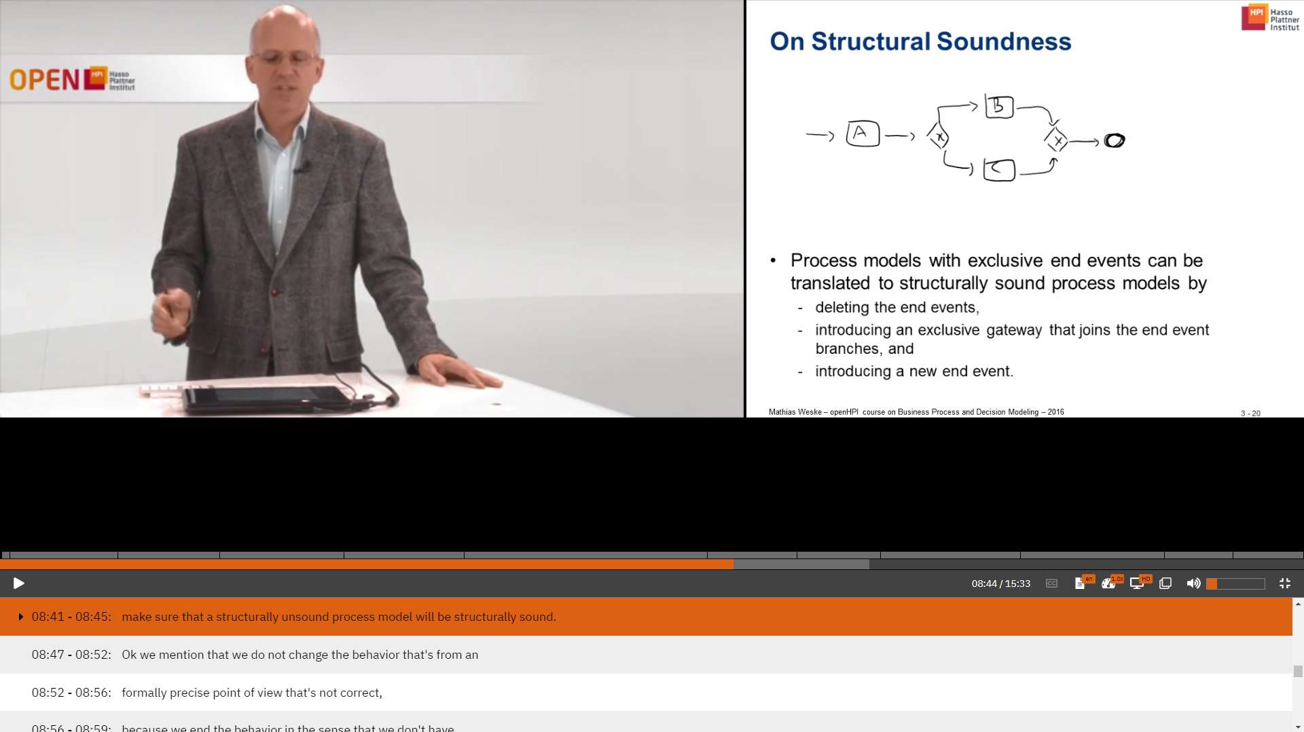
To start formal analysis
Now we transform the structurally unsound process into structurally sound process.

Slide 18
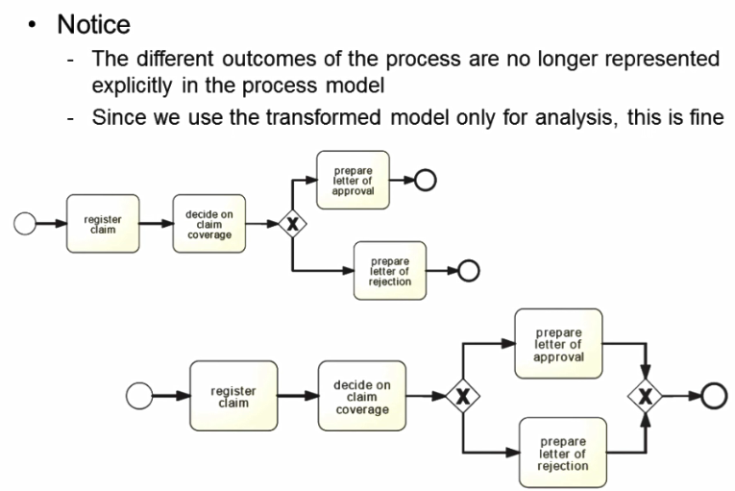
Structural sound

Slide 19
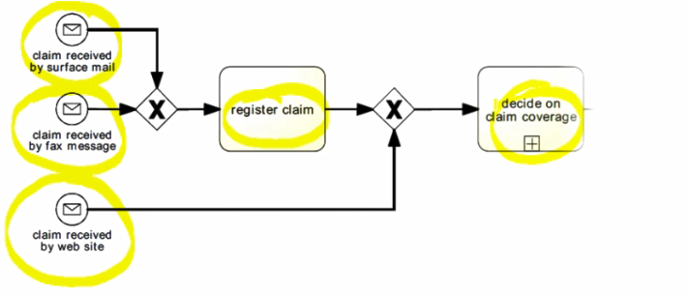
Multiple start Events.
We can see process models with multiple start week.

Slide 20
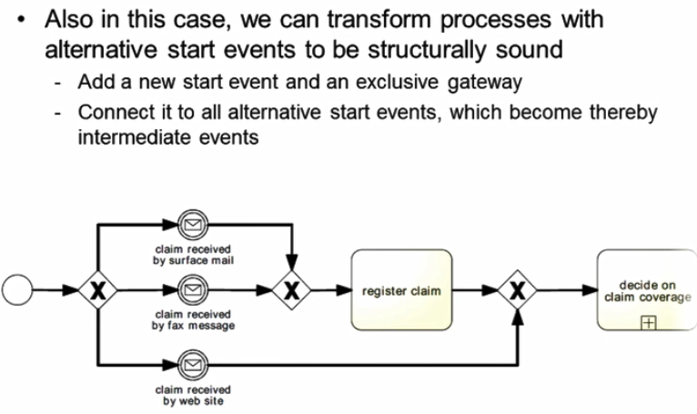
How to transform

Slide 21
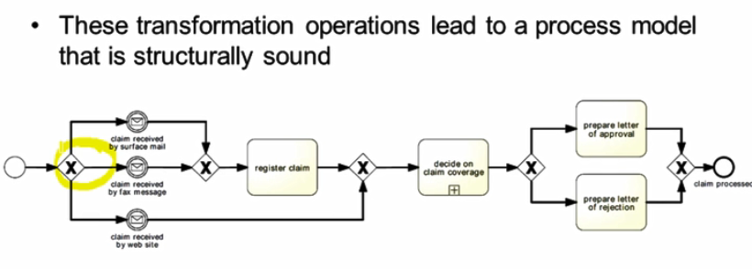

Slide 22
Relaxed Soundness
The idea of relaxed soundness is that for each transition there is a firing sequence that relaxed soundness allows business process models that expose deadlock behavior
A process is relaxed sound if each task of the business process is part of a properly terminating sequence..

Slide 23
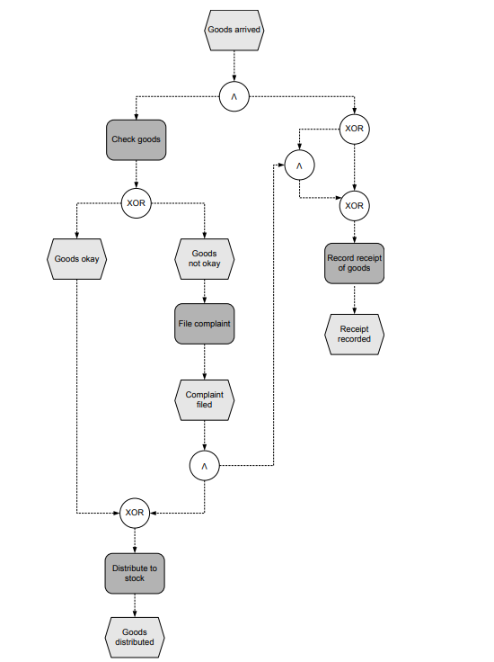
If the exclusive or split selects the and join branch but the goods are okay, the and join waits permanently for the filed complaint, which will never appear. As a result, the process is stuck in a deadlock situation.
If the exclusive or split does not select the and join branch, but the goods are not okay, the and split cannot fire, because just one incoming edge— the filed complaint—is signalled. In this case, the receipt of the goods is registered, but the complaint on the quality of the goods is lost

Slide 24
Weak Soundness
Weak soundness disallows deadlocks, but it allows certain parts of the process not to participate in any process instance,
A workflow system (P N, i) is weak sound if and only if the following holds:
• For every state M reachable from state i there exists a firing sequence leading from M to o, i.e.,

Slide 25
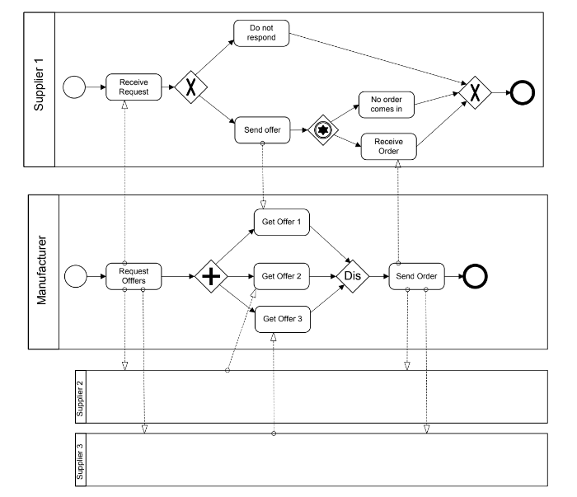
Lazy Soundness
assume that the offers received from Suppliers 1 and 2 have led to the activation of the join. Further assume that the offers from Suppliers 3 and 4 arrive only after the final event has been reached. Then, receiving the offers for Suppliers 3 and 4 and paying them are lazy activities.

Slide 26
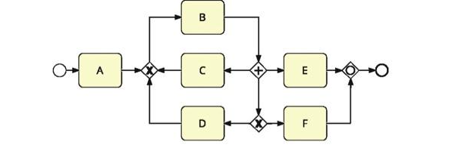
Exercise

Slide 27
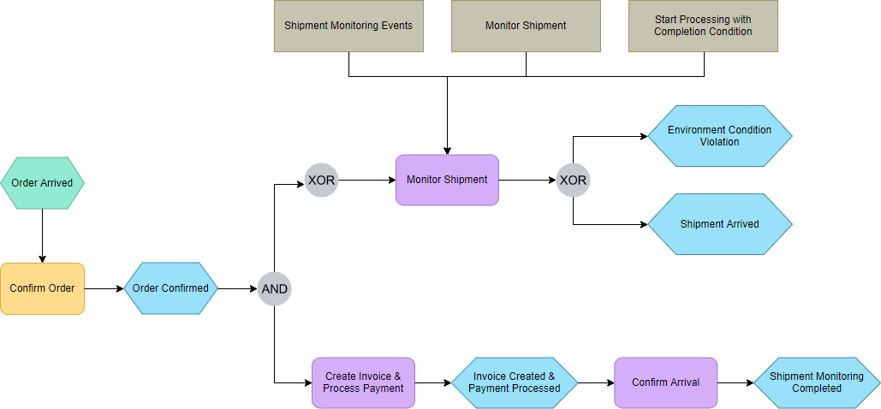
Process Notation
BPMN Notation
Event driven process chain (EPCS)
Petri nets

Slide 28
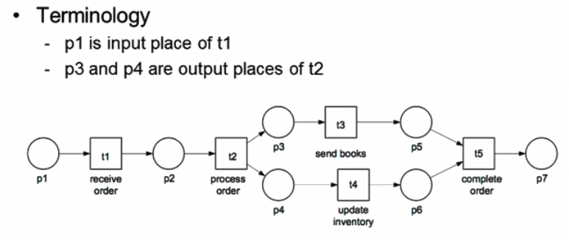
Petri nets
Petri nets are directed graphs devised to represent the concurrent behavior of dynamic systems.
The behavior of Petri nets is represented by tokens moving over the places of petrinet
Should be free of obvious anomalies of soundness.

Slide 29
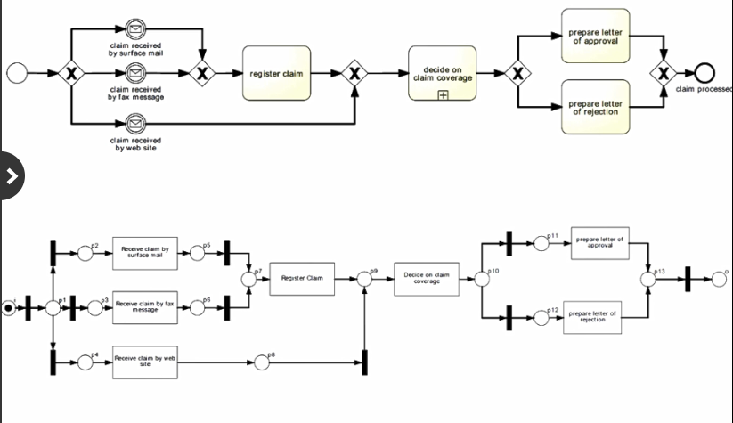
Petrinets : Modeling Representation

Slide 30
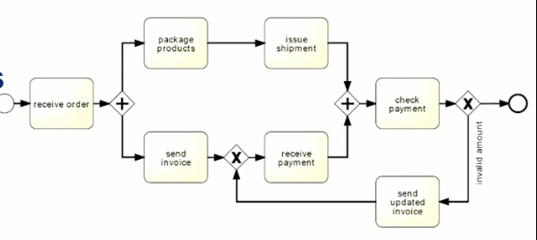
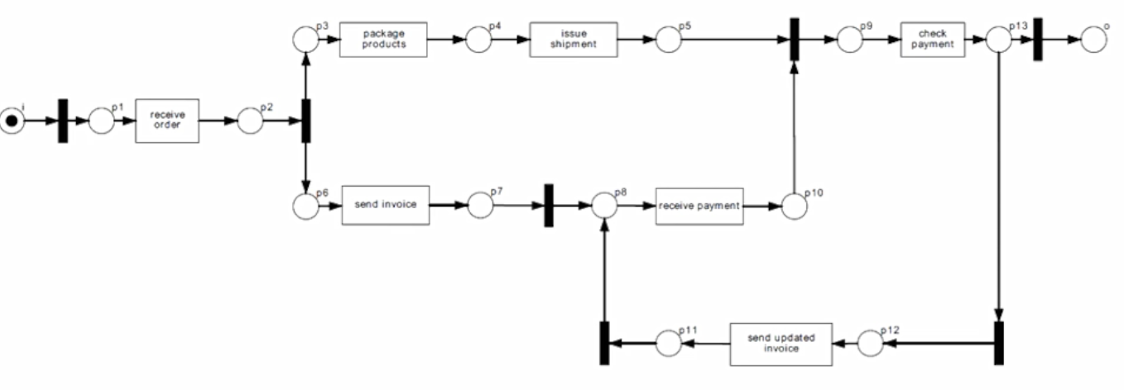
Example

Slide 31
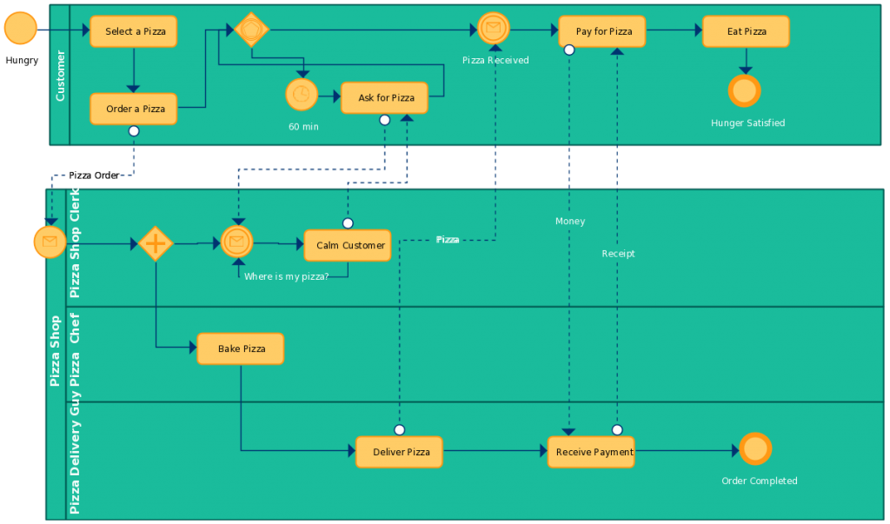
Example

Slide 32
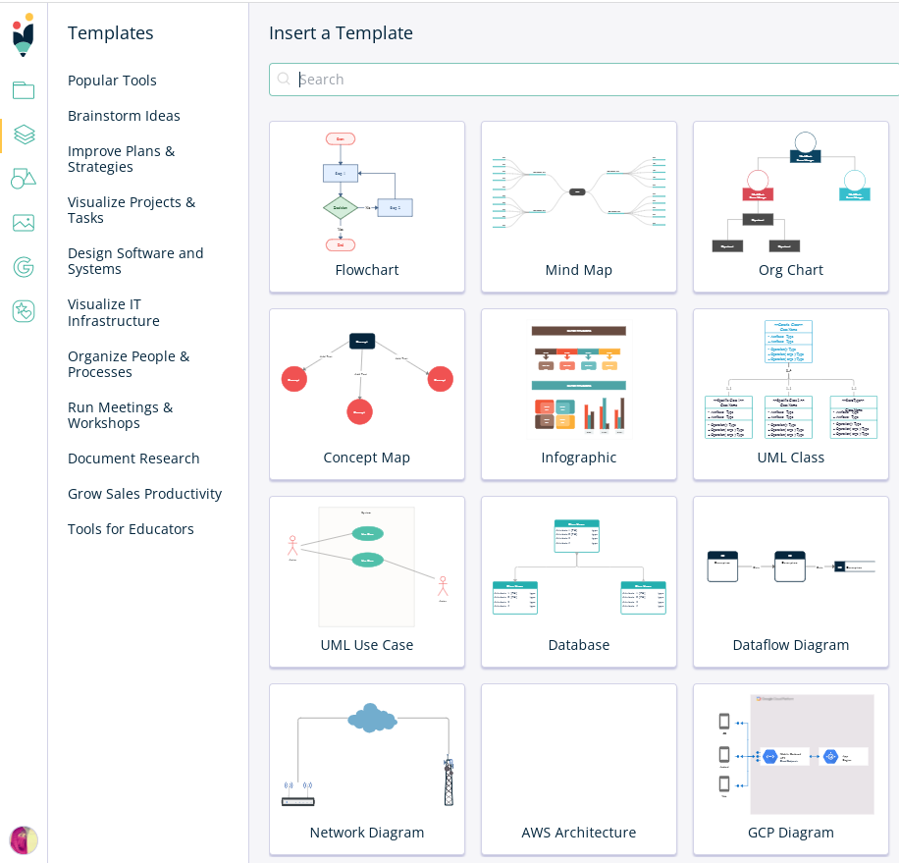
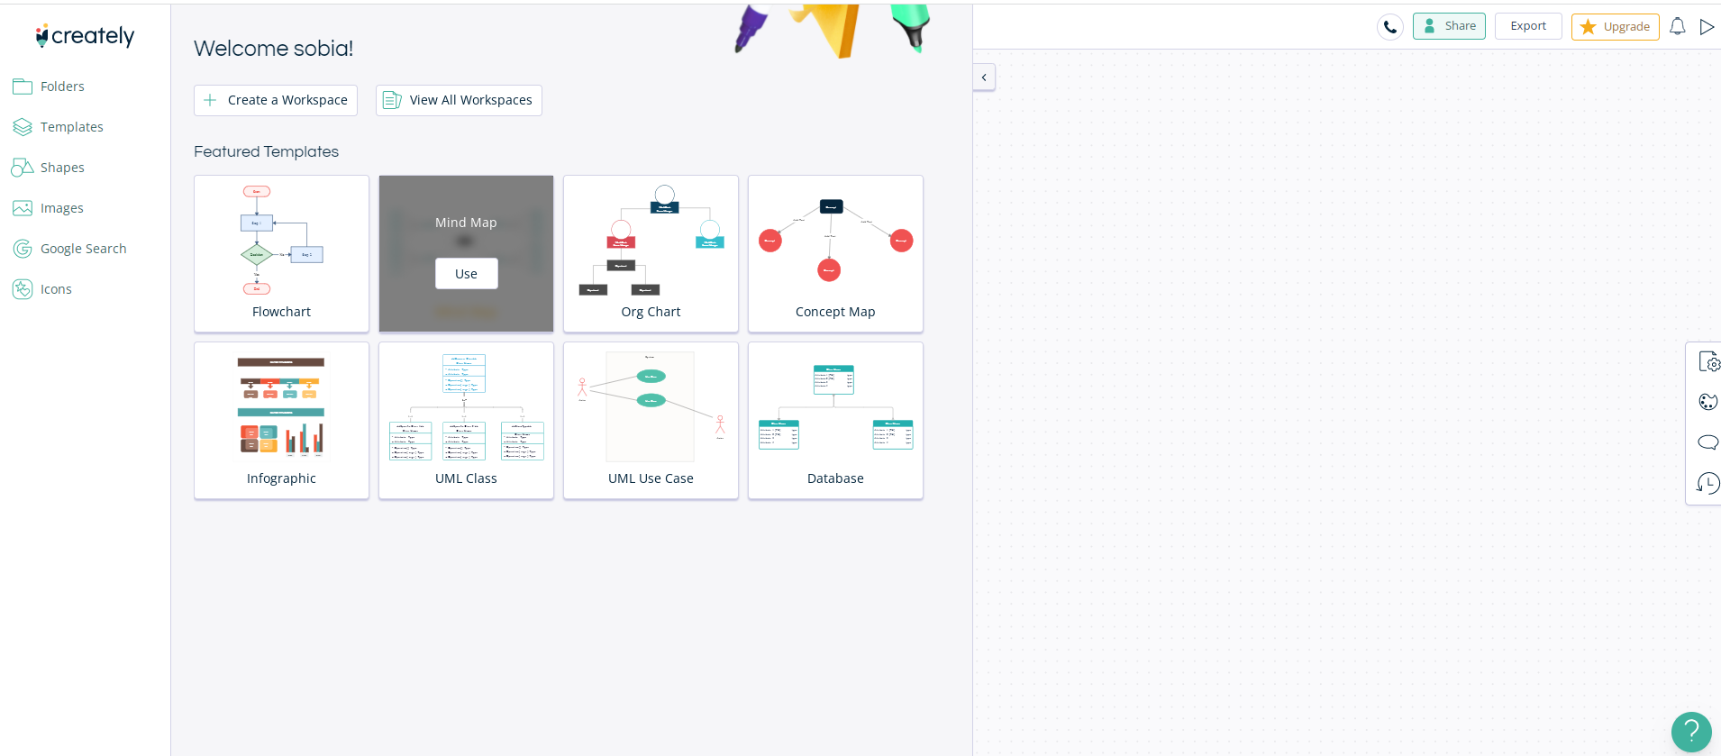
https://app.creately.com/diagram/TdR0Mb7tj1t/edit

Slide 33
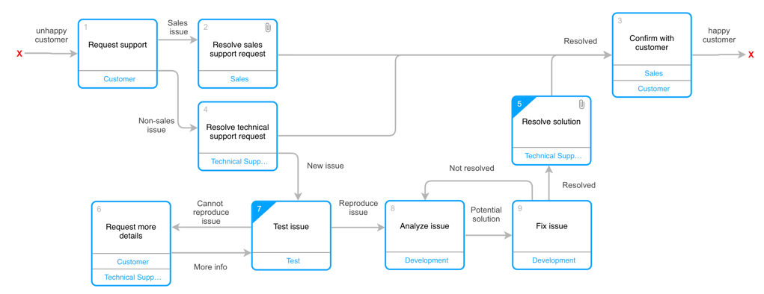
Universal Process Notation

